Slide 1

Zomato Data Analysis
Vu Ho
Jun - 28 - 2024

Slide 2

OUTLINE
Introduction
Methodology
Results
Visualization – Charts
Dashboard
Discussion
Findings & Implications
Conclusion

Slide 3

INTRODUCTION
Objectives:
This project aims to find the trend of restaurant and their services around the city to predict a restaurant model trend.
Background:
A stakeholder wants to open a restaurant, and he wants to know what type of restaurant and services that people like the most. This project will help him to decide what type of the restaurant and services that he want to build and provide to the people.

Slide 4

METHODOLOGY
Data source:
Using a given dataset of 148 restaurants around the city.
Using Python libraries to explore the given data and find the trends.
Using Data Visualization to represent the trends to stakeholder.

Slide 5
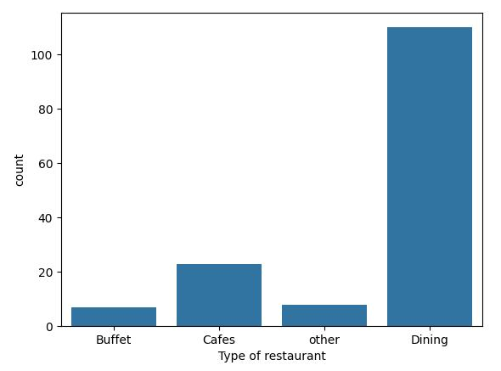
KEY FINDINGS
Dining restaurants are preferred by a larger number of individuals

Slide 6
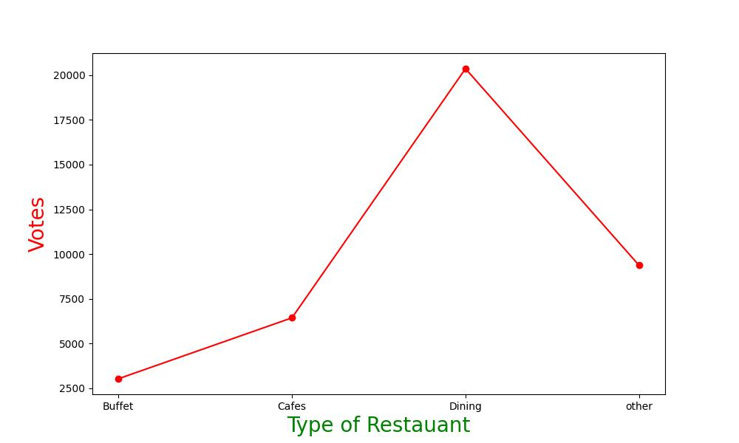
KEY FINDINGS
Dining restaurants are preferred by a larger number of individuals

Slide 7
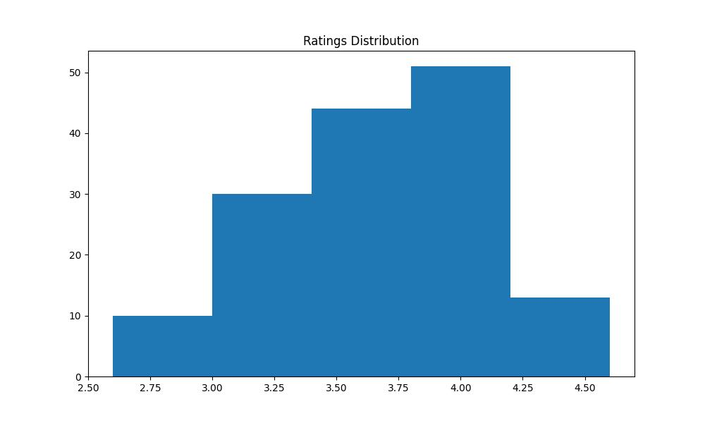
KEY FINDINGS
The majority of restaurants received ratings ranging from 3.5 to 4.

Slide 8
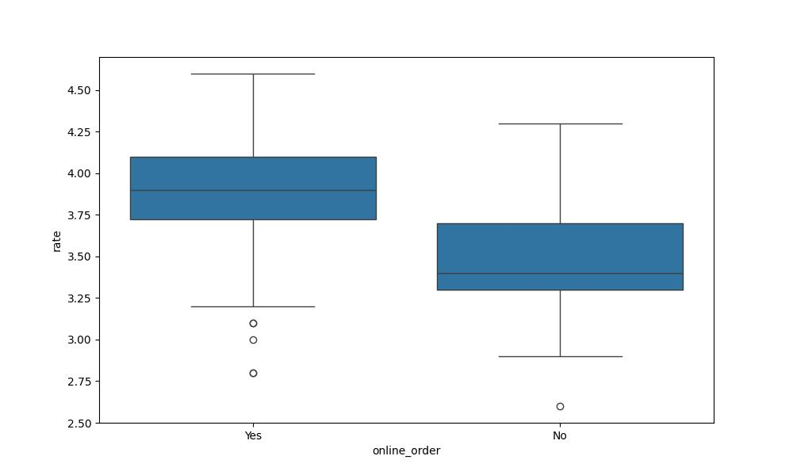
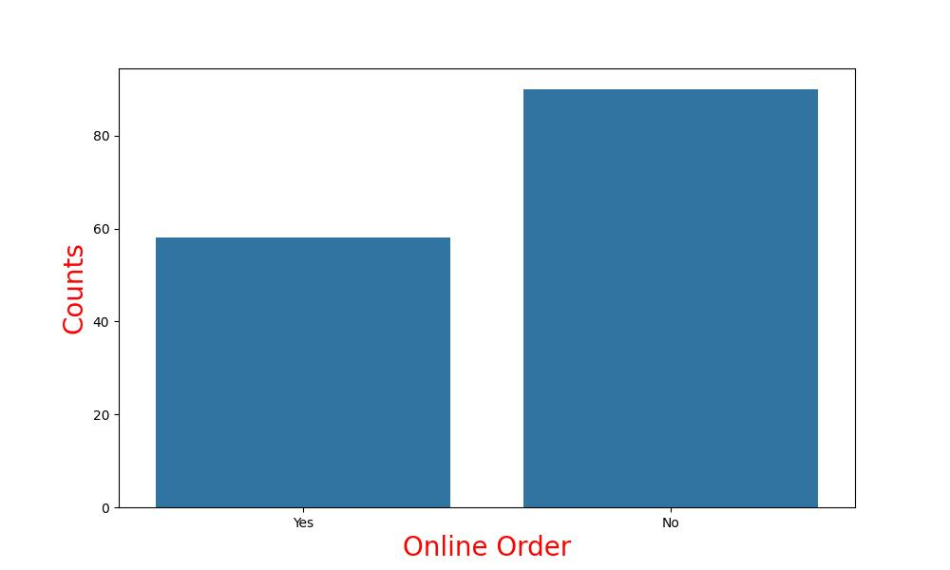
KEY FINDINGS
Offline orders received lower ratings in comparison to online orders, which obtained excellent ratings.

Slide 9
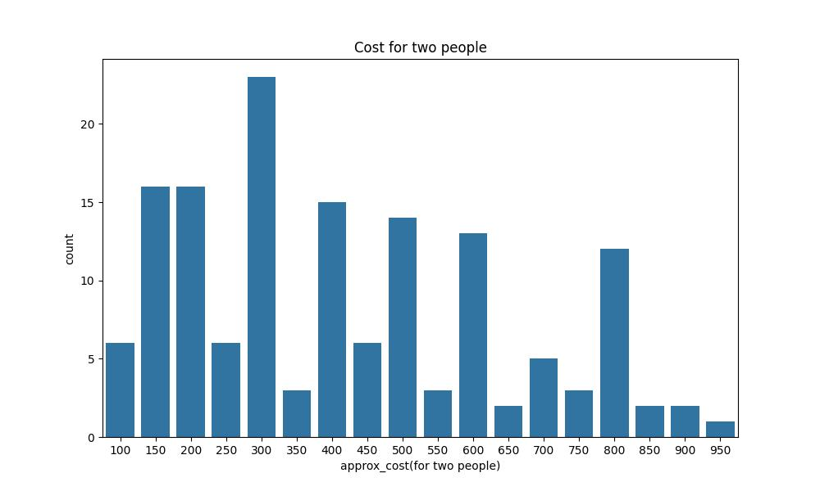
KEY FINDINGS
The majority of couples prefer restaurants with an approximate cost of 300 rupees.

Slide 10

CONCLUSION
The analysis indicates that dining restaurants are the most preferred type of establishment among customers. The majority of restaurants received ratings between 3.5 and 4.0, highlighting a generally satisfactory experience. However, offline orders were associated with lower ratings compared to online orders, which received excellent ratings. Additionally, it was observed that the majority of couples prefer restaurants with an approximate cost of 300 rupees. These insights can assist stakeholders in making informed decisions about the type of restaurant and services to offer, aligning with customer preferences and market trends.

